Slide 1
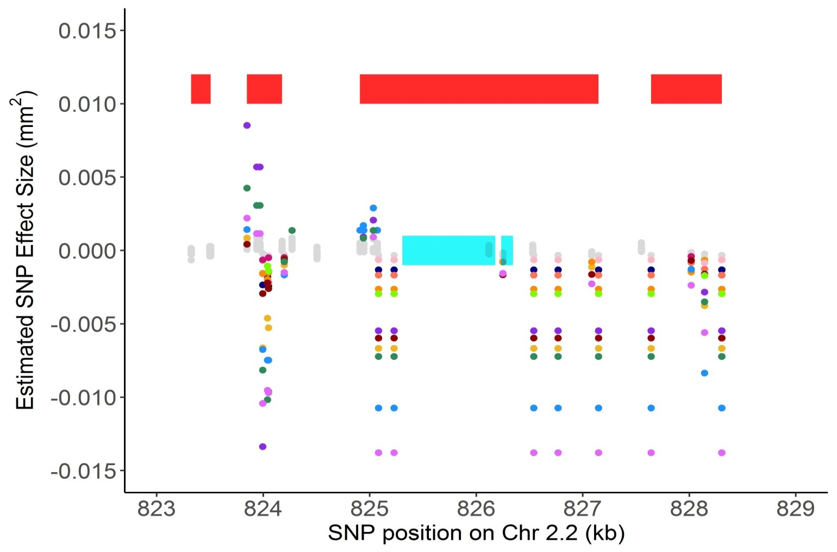
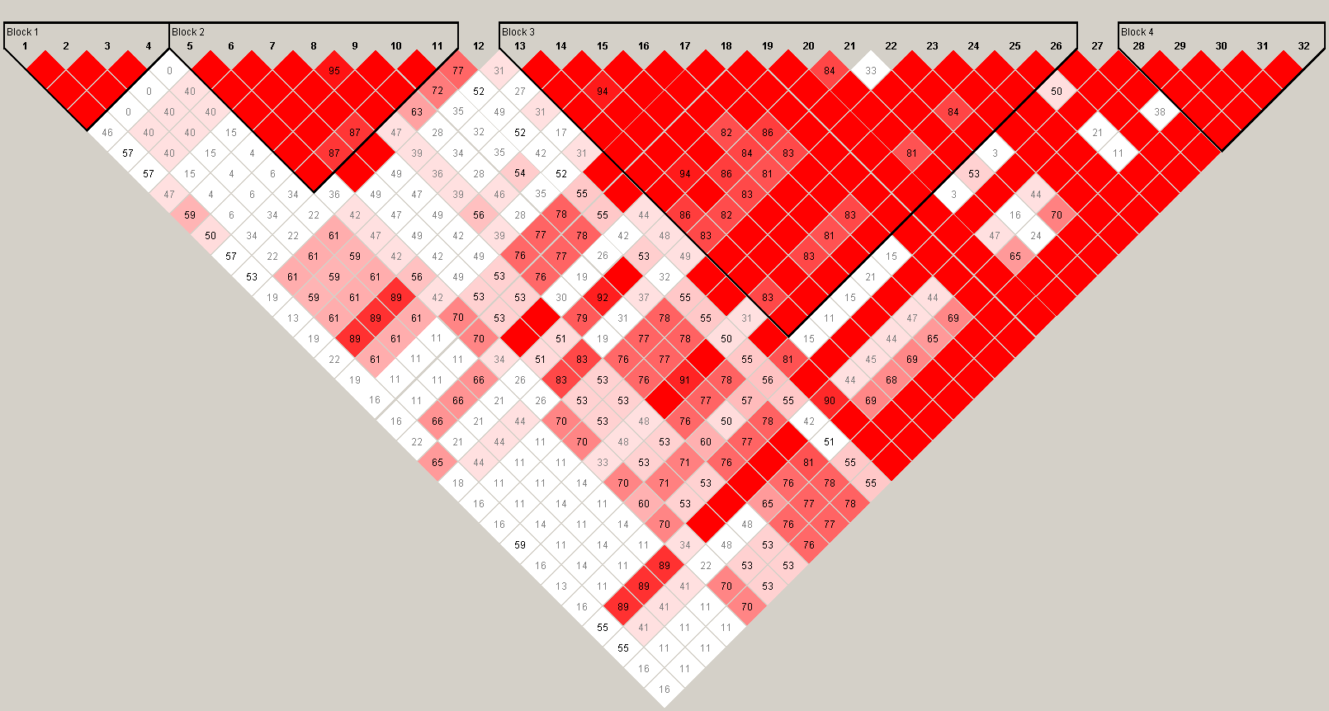
a
Block 1
Block 2
Block 3
Block 4
b
Notes:
Figure 6.

Slide 2
Figure 6. Host specificity of significant SNPs linked to the gene BcT4_6001 (Bcin14g00870).
a) SNPs with effects estimates above the 99% permutation threshold are colored by trait (plant phenotype in which the effect was estimated). BcT4_6001 (Bcin14g00870) is a pectinesterase gene linked to at least one significant SNP on all 12 of the tested tomato accessions by bigRR. The annotated exons are depicted as turquoise rectangles, with the start codon marked with an arrow indicating the direction of transcription. Red rectangles indicate corresponding linkage disequilibrium blocks from Figure 6b.
b) Linkage disequilibrium plot, including all pairwise comparisons of SNPs in the 2kb region surrounding Bcin14g00870. The color scheme for each SNP pair is D'/LOD: white if LOD <2 and D’ <1, bright red for LOD ≥2 and D’=1, intermediate shades for LOD≥2 and D’<1.

